Slide 1
Blur image restoration with Deep learning
Ran Minerbi

Slide 2
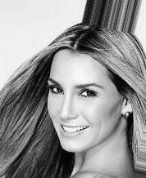
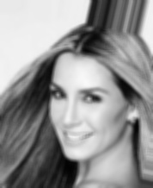

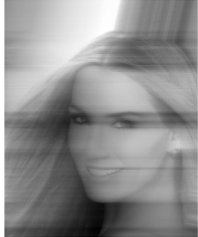
Blur images

Slide 3
Calculate transfer function H(u,v) for blur image caused by uniform acceleration for

Slide 4
Restore with ax,ay

Slide 5
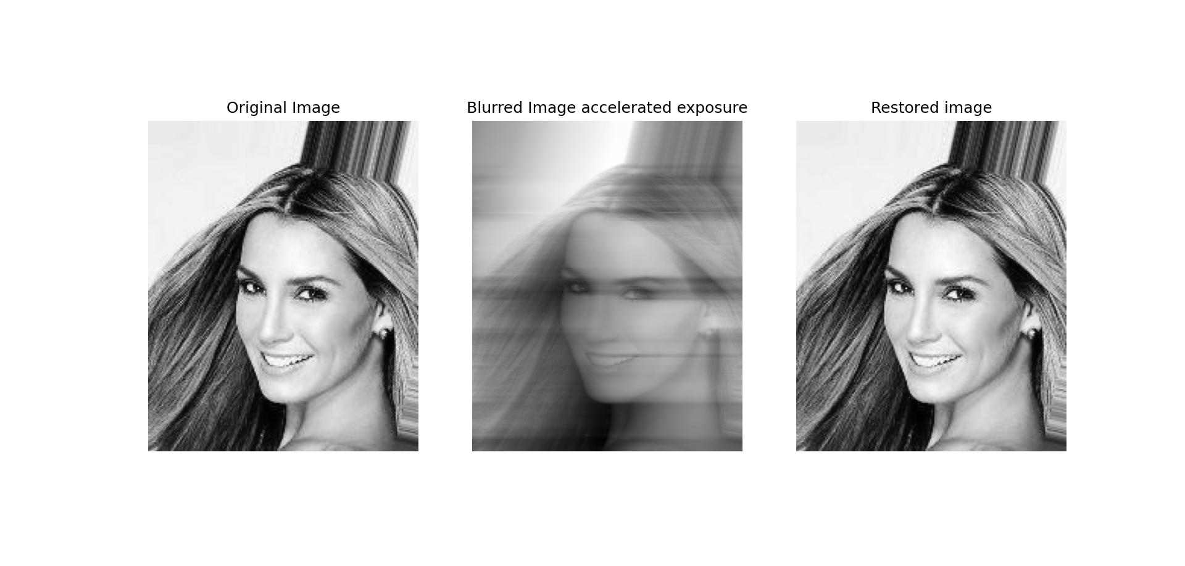
Image restore with (ax,aY)

Slide 6
Is it possible to restore images not knowing (ax,ay) ?

Slide 7
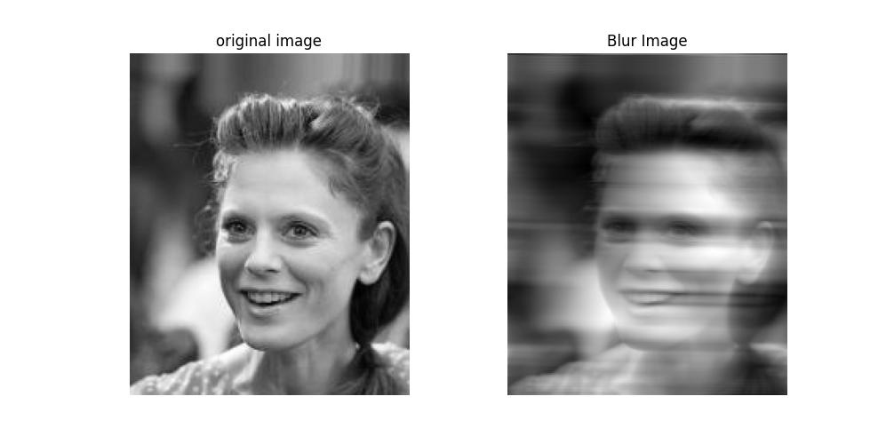
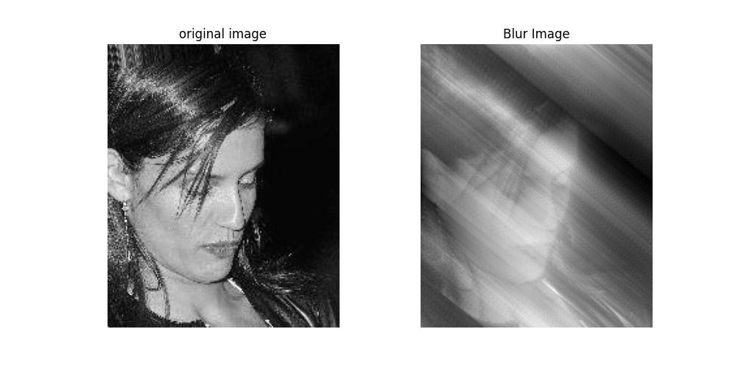
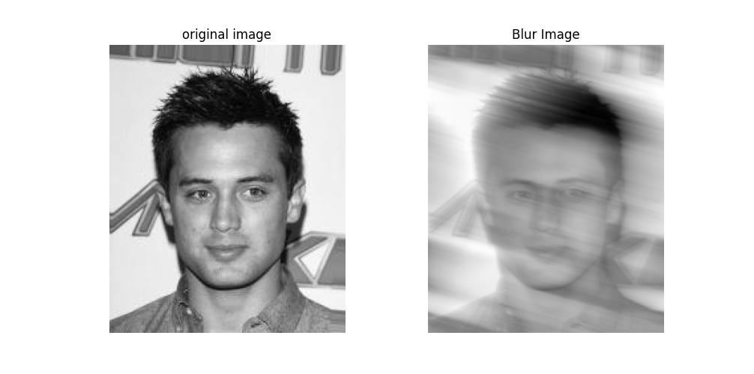
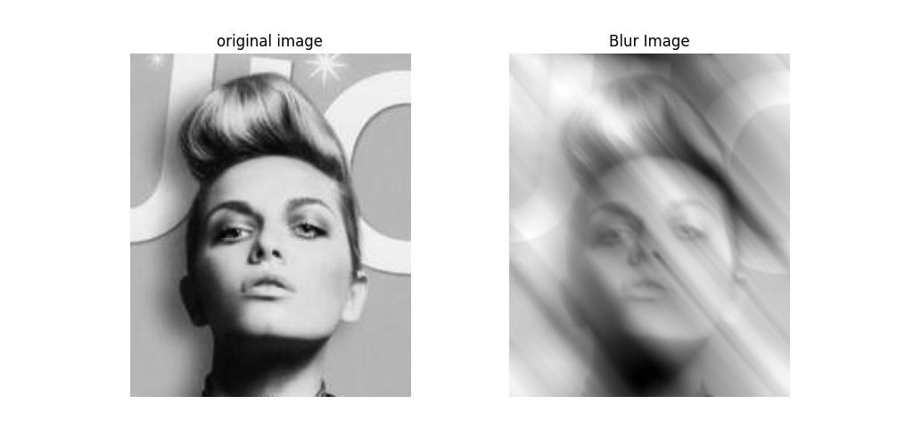
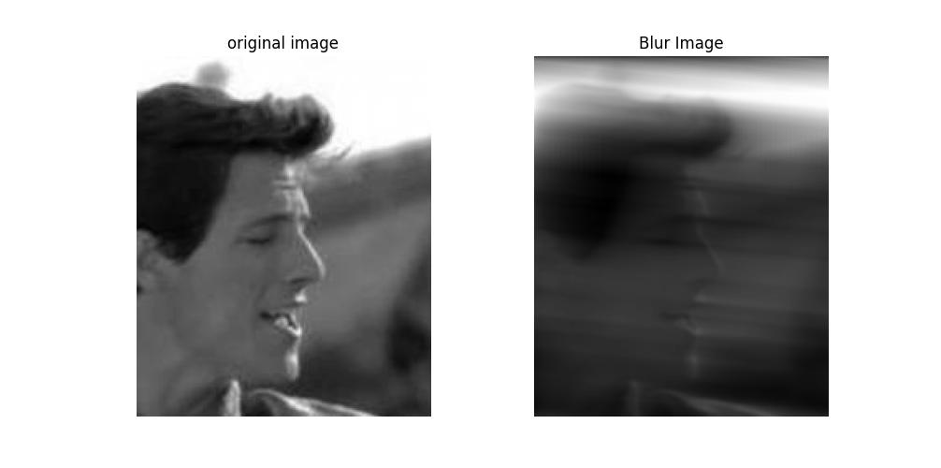
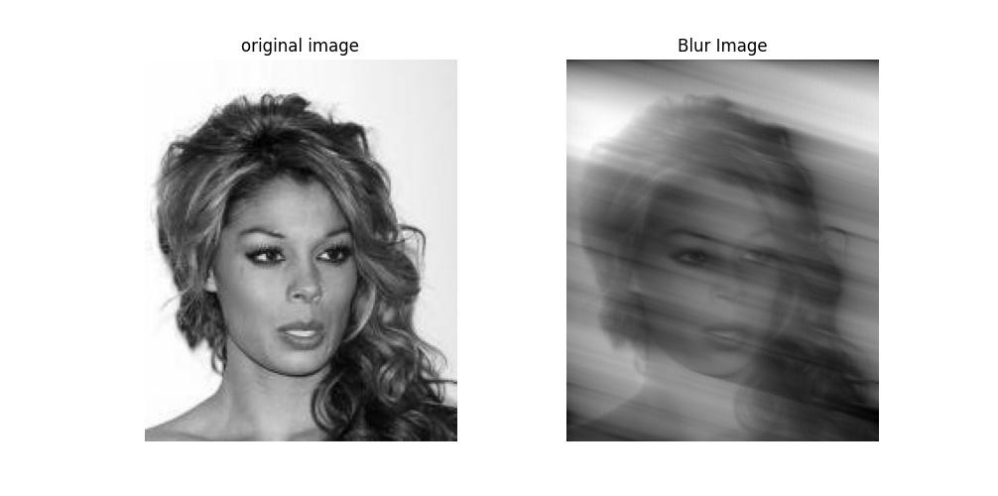
Solution procedure
Distort images on purpose within known acceleration parameters (ax,ay)
Train set of 150 blurd images
Train labels of 150 (ax,ay)
Test set of 50 blurd images
Test Labels on 50 (ax,ay)

Slide 8
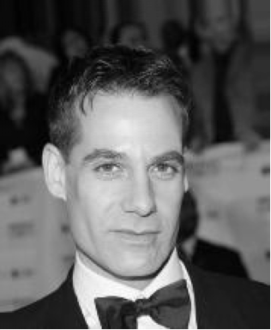
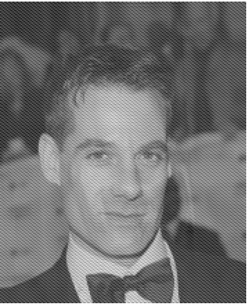
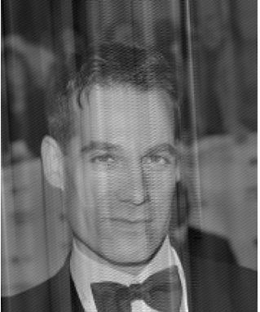
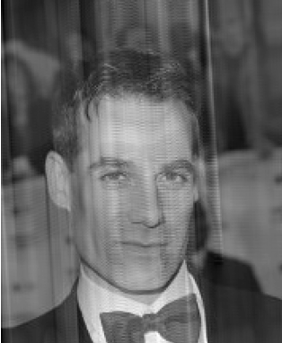
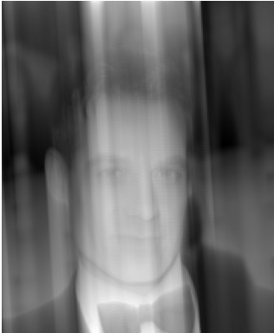
Accuracy is critical
(Ax,Ay) = [0.0916516522235391, 1.4724174320412484]
Err(Ax) = 0
Err(Ay) = 0.1
Err(Ax) = 0.1
Err(Ay) = 0.3
Err(Ax) = 0.1
Err(Ay) = 0.5
blurd image
Filtered image

Slide 9

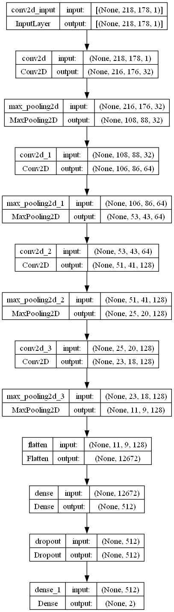
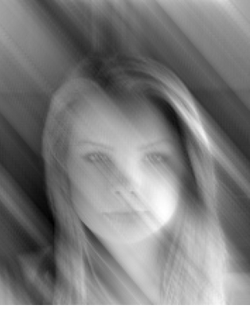
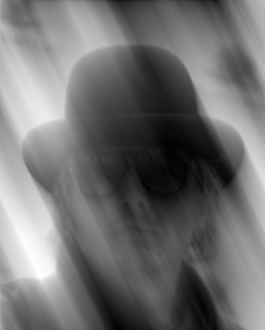
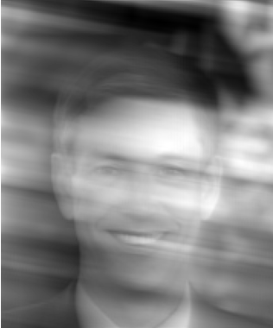
Approach 1 Convolution DL network
. . .
(Ax,Ay)

Slide 10
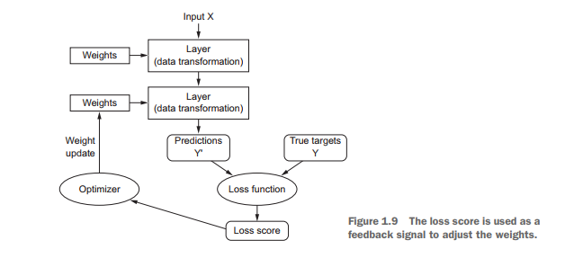
Training loss outline procedure
Loss should be minimized during training

Slide 11
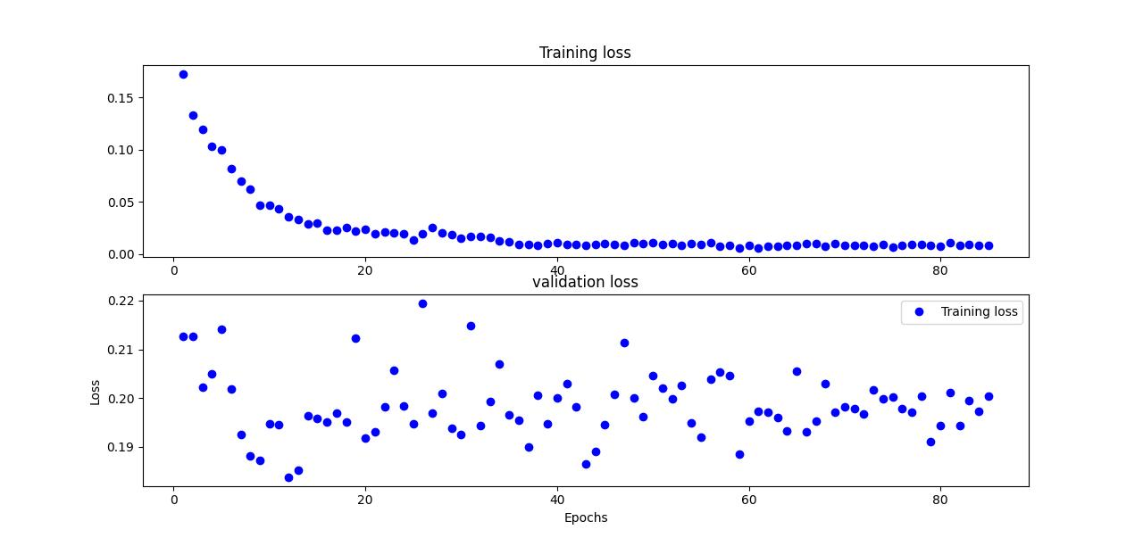
Approach 1 Convolution DL network

Slide 12
Overfit
Optimization refers to the process of adjusting a model to get the best performance possible on the training data, whereas generalization refers to how well the trained model performs on data it has never seen before
Learning how to deal with overfitting is essential to mastering machine learning
Avoid overfitting :
Get more training data
Reduce network capacity
Add weight regularization
Add dropouts

Slide 13
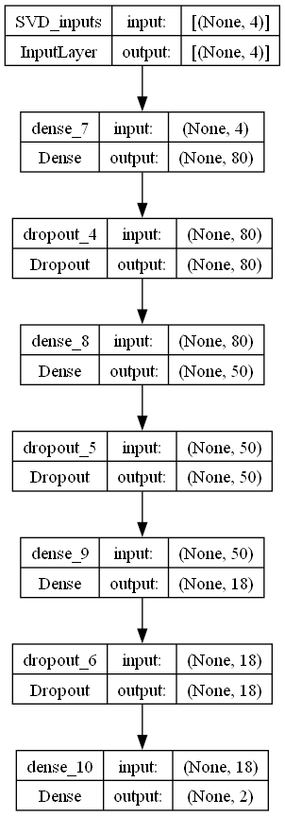
Approach 2 Covariance matrix with fully connected DL network
(Ax,Ay)

Slide 14
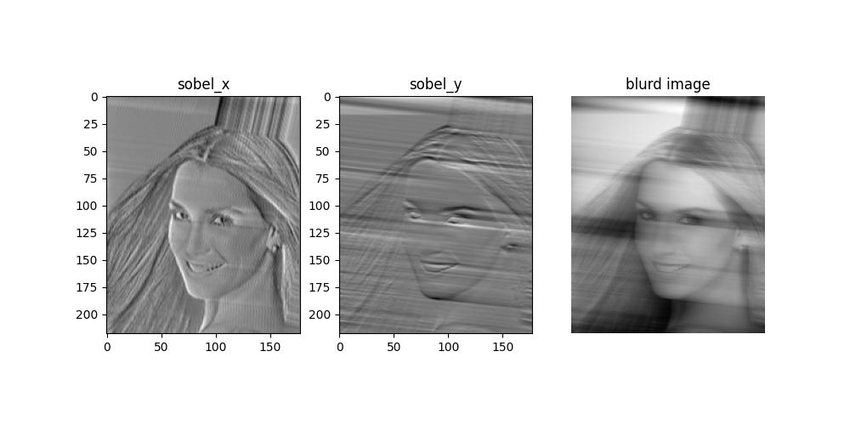
Approach 2 Covariance matrix with fully connected DL network

Slide 15
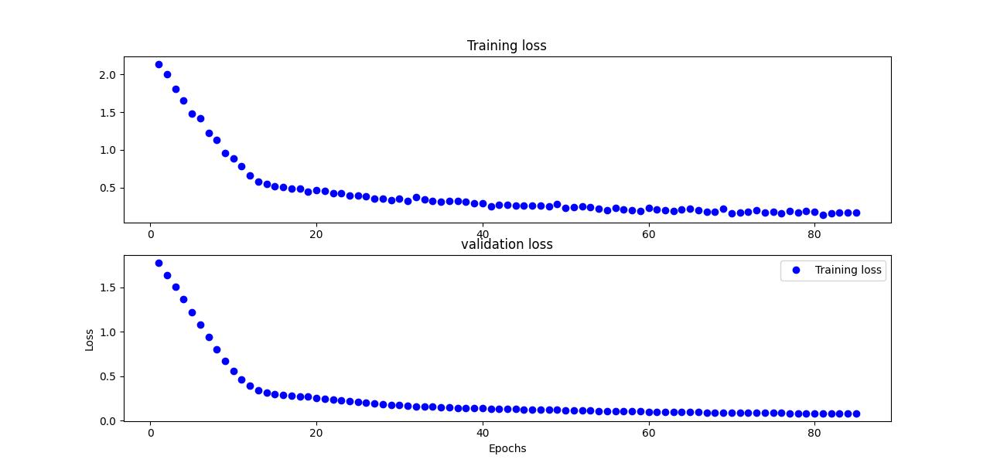
Approach 2 Covariance

Slide 16
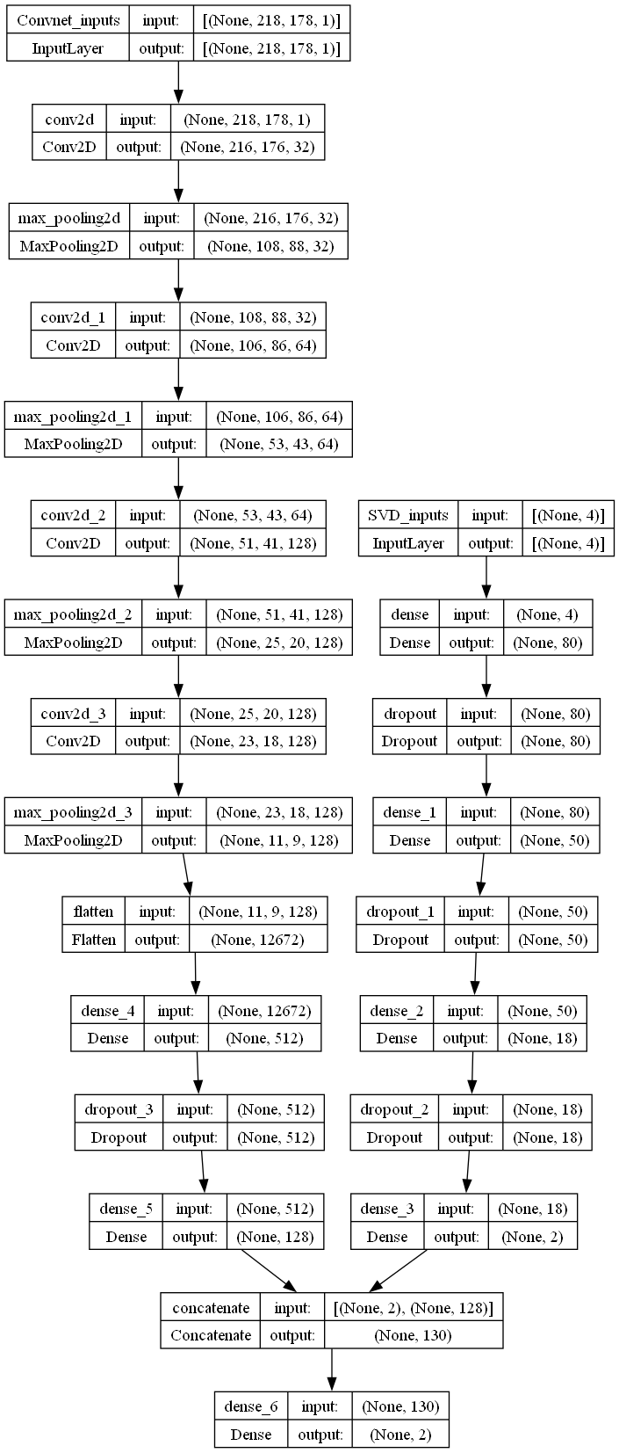
ApproacH 3 ConvNet- Covariance

Slide 17
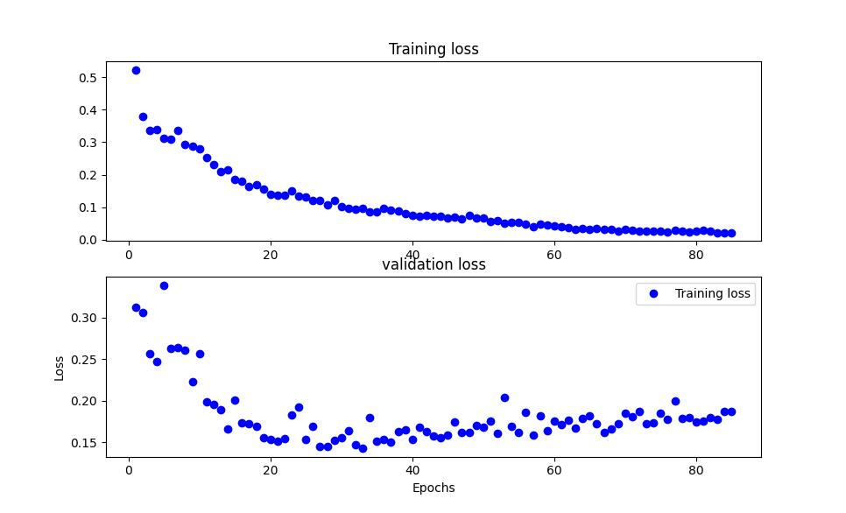
ApproacH 3 ConvNet- Covariance

Slide 18
Approach 4 CONVNET over SOBEL

Slide 19
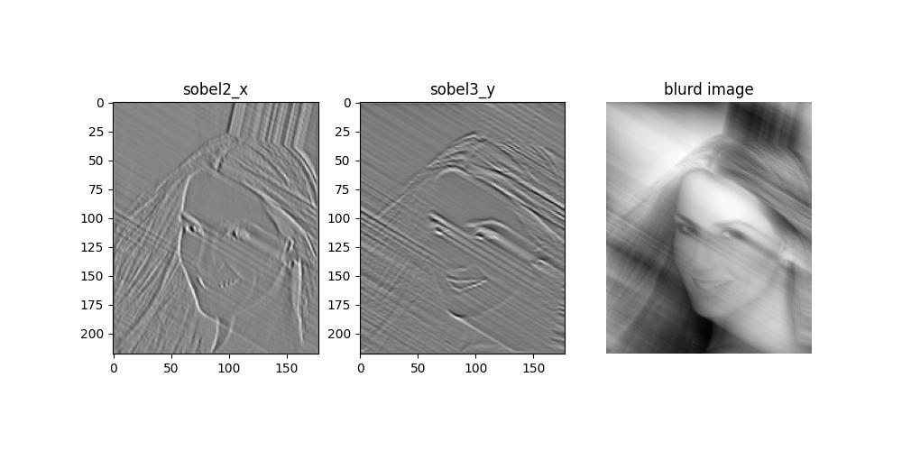
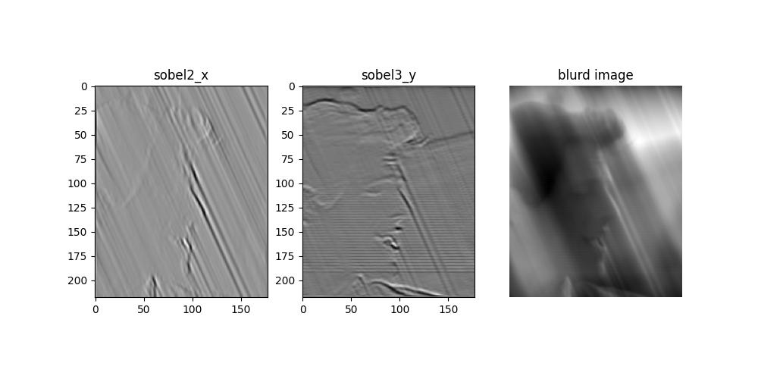
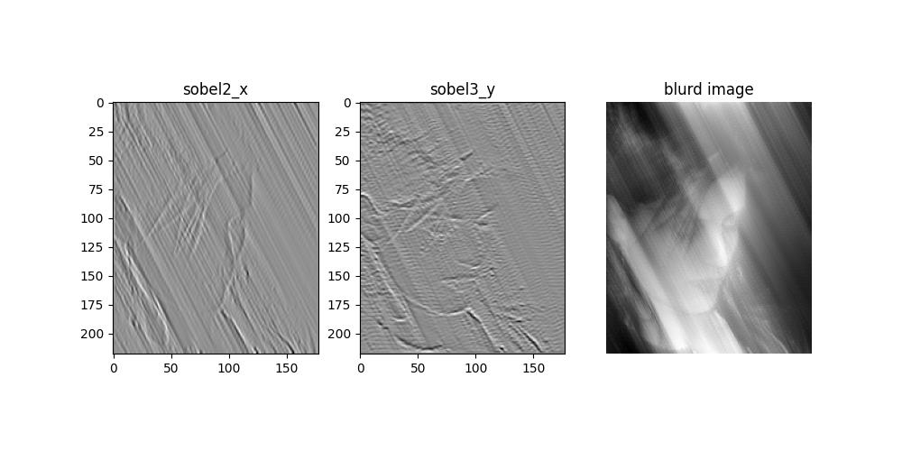
Approach 4
X DL path
Y DL path
Ax
Ay

Slide 20
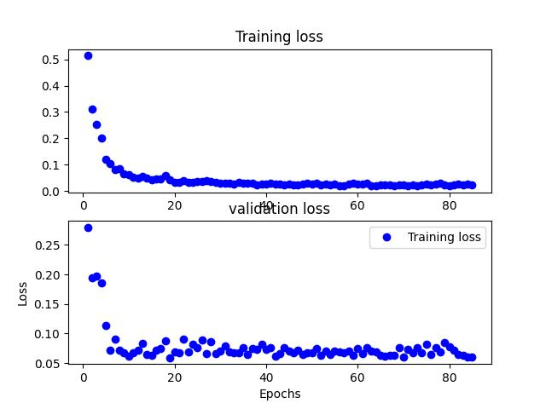
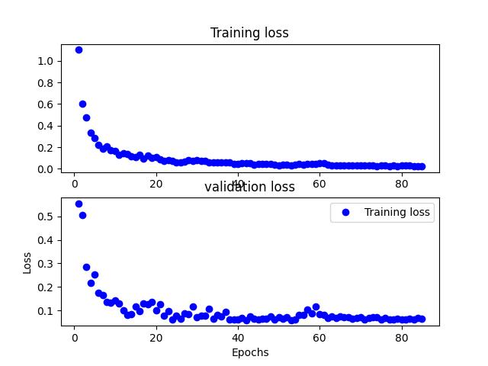
Approach 4 train and validation loss
x
y

Slide 21
